Slide 1


Bank of Baroda Hackathon - 2022
Technology Partner
Your Team Name : KEIZEN
Your team bio : Data analyst
Date : 07-09-2022

Slide 2
Problem Statement?
Why did you decide to solve this Problem statement?
Now a days, Lot of thefts happening mostly in Banks so that People suffering a lot and also it is creating a bad impression for the banks.
Hence,Its necessary to find a solution for this issue…..

Slide 3
User Segment & Pain Points
Which user /advertiser segment would be early adopter of your product & why?
We will create on our own..

Slide 4
Pre-Requisite
What are the alternatives/competitive products for the problem you are solving?
It’s fully comprised of sensors instead of high cost cameras.

Slide 5
Azure tools or resources
Azure tools or resources which are likely to be used by you for the prototype, if your idea gets selected We decided to use Cheap and best Softwares which will be helpful for the effective communication for the sesnors..

Slide 6
Any Supporting Functional Documents
Present your solution, talk about methodology, architecture & scalability
Object Counter circuit where the object/person passes in front of an LDR.
As object passes, it blocks the incoming light on surface of LDR and the counter increases the counts it.
Infrared sensors are a specific type of motion sensors that use infrared radiations to detect people entry and it send signal to alarm.
EQ-Radio instead wireless signals that reflect off of a person’s body and back to the device. Its beat-extraction algorithms break the reflections into individual heartbeats and analyze the small variations in heartbeat intervals to determine their levels of arousal and positive affect

Slide 7
Key Differentiators & Adoption Plan
How is your solution better than alternatives and how do you plan to build adoption?
Its very simple and cheap
cost effective.
Accurate.
Long life..

Slide 8
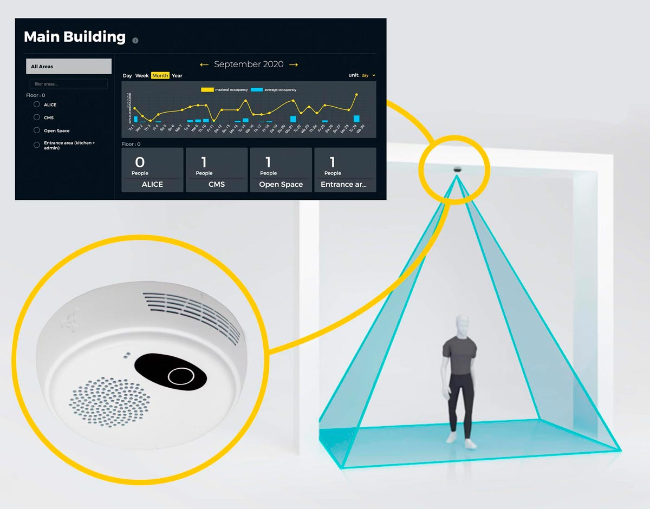
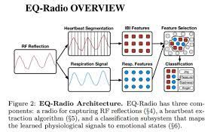
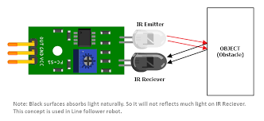
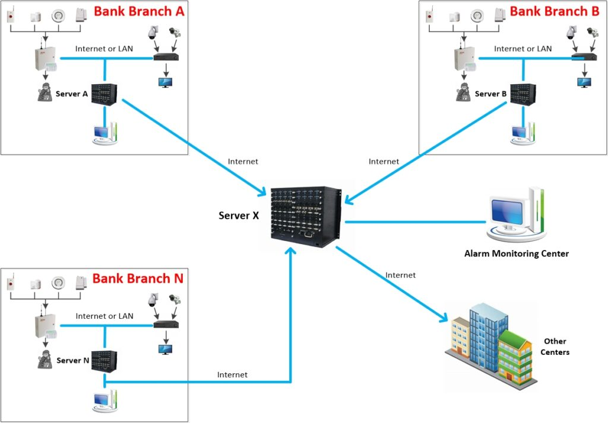
GitHub Repository Link & supporting diagrams, screenshots, if any
How far it can go?

Slide 9
Thank You
Team member names : Moahanapriya vadivel

